Slide 1
Welcome to our EYFS Everything you need to know prior to your child starting with us in September

Slide 2
Class names
If you are in Mrs Wolfson’s Class you are the Dragonflies
If you are in Mrs Caton’s Class you are in the Butterflies

Slide 3
The first day – Thursday 2nd September
School starts on THURSDAY 2nd September
The Nursery day starts at 8:45 and finishes at 11:45
The Reception day starts at 8:55 and finishes at 3:15
To access the classrooms please use the driveway that leads up to Poplar’s primary school and come in though the gate. Staff will be there in high vis jackets so please ask if you are unsure.
Your child will need their bookbag, full school uniform, a hat, water bottle and coat.
Please ensure EVERYTHING is named

Slide 4
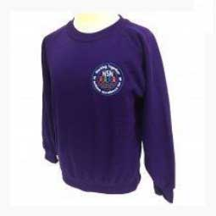
School Uniform for Nursery and Reception
Purple school jumper or cardigan with or without the school logo
Black or grey trousers/shorts / skirt or dress
Purple gingham dress
Black Velcro or buckle school shoes – no trainers
Black / grey/ white socks
Long hair must be tied back

Slide 5
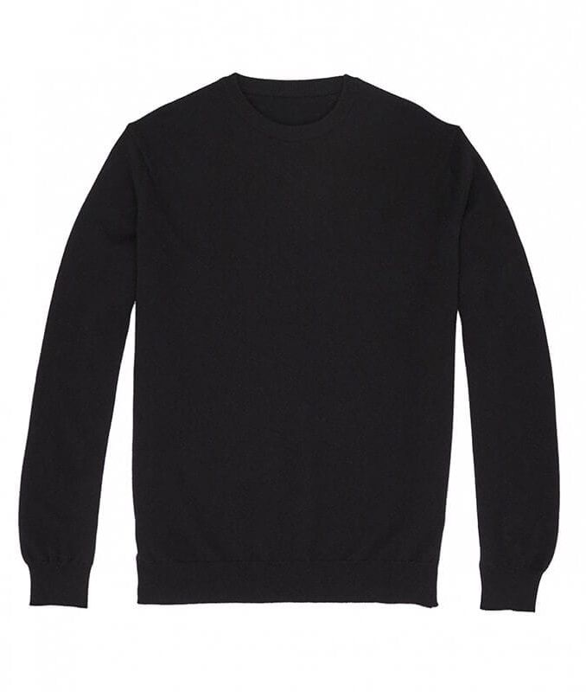
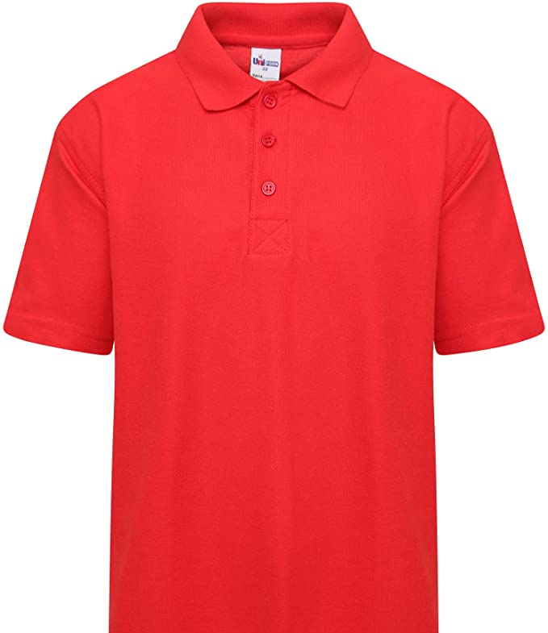
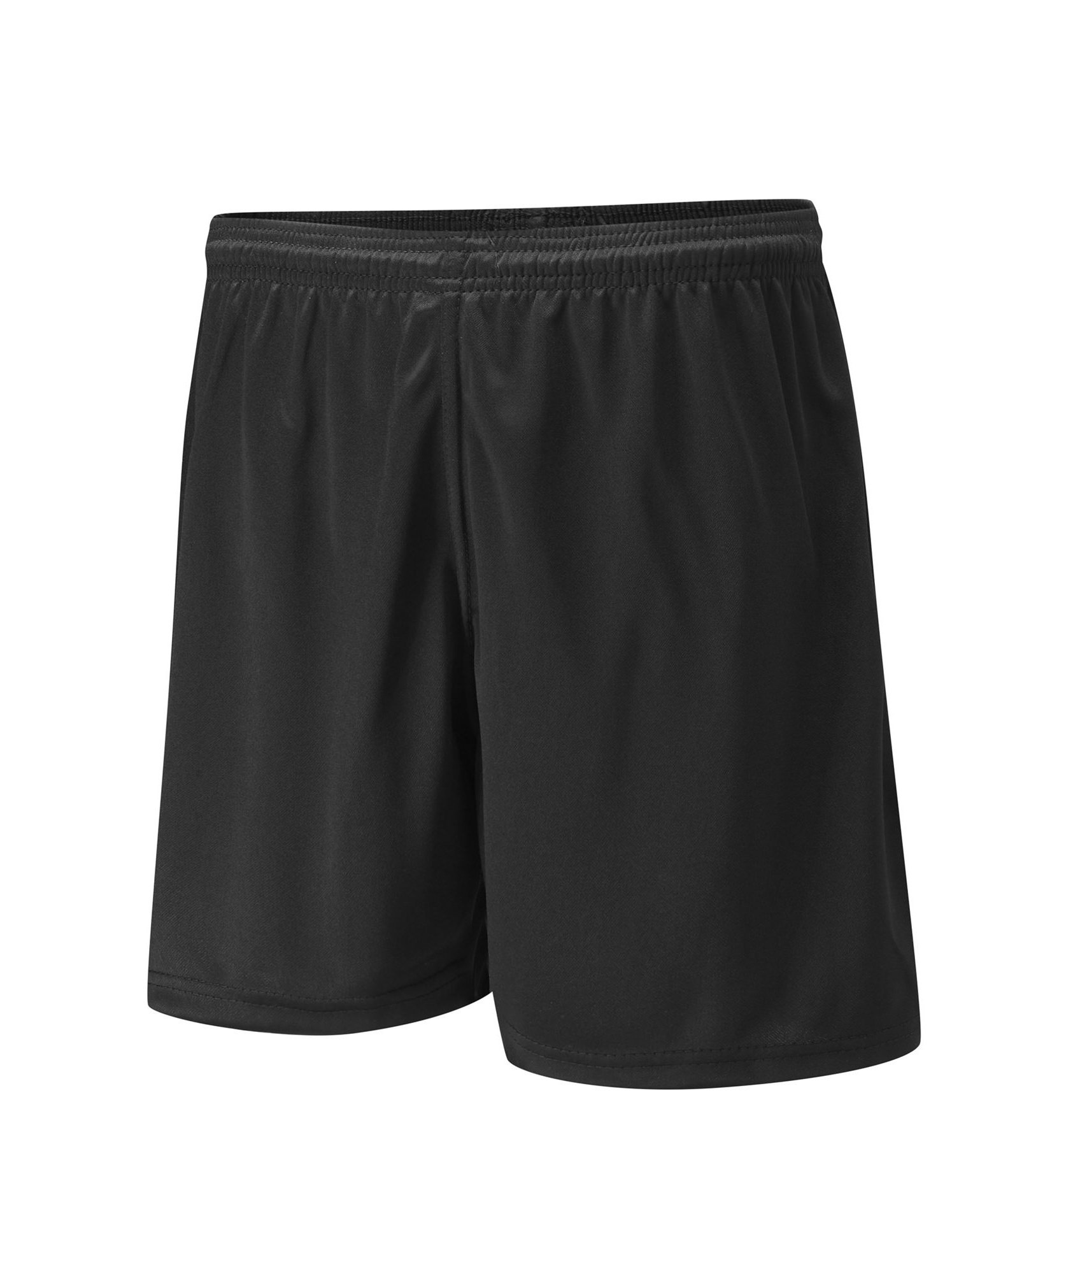
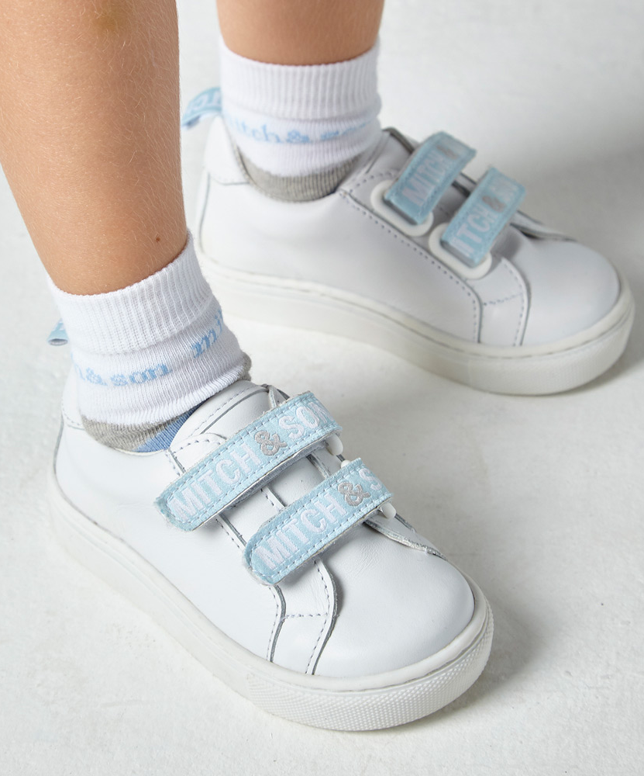
PE
Reception children will have PE once a week
They will need a red polo t shirt, black jumper, shorts and trainers or plimsols
Please name all PE kit
PE kit should be in a separate bag and taken home weekly

Slide 6
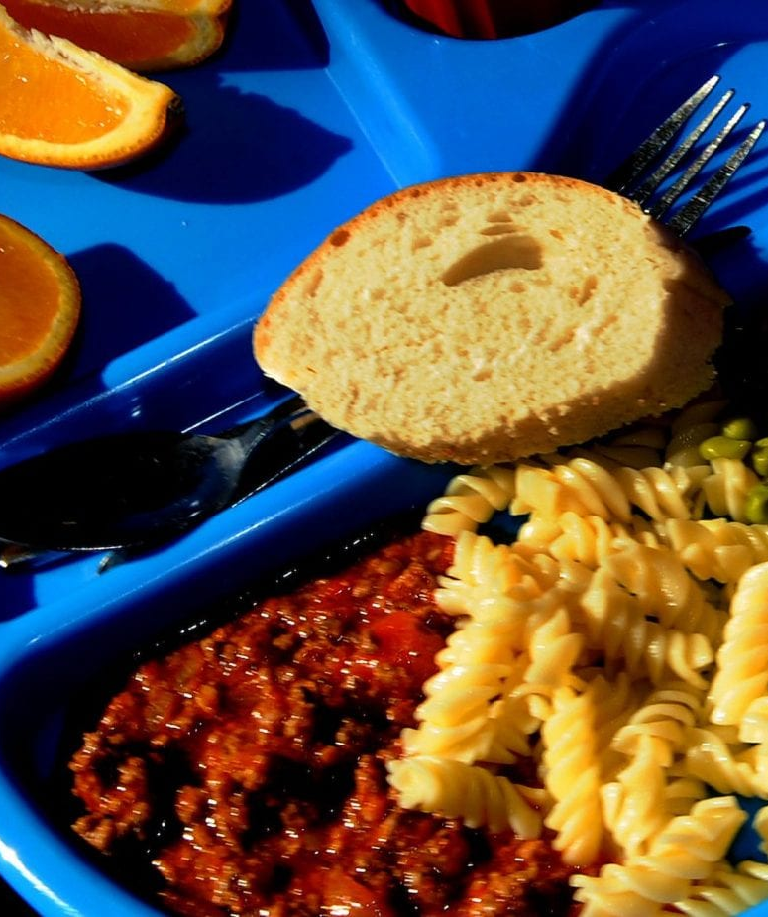
School lunches
Reception children are eligible for a free school dinner every day
There are hot and cold options available
The dinner menu is available on our school website and Facebook page
Your child can choose each morning what they would like for their lunch
All EYFS staff support the children in the hall during their first few weeks along with our midday supervisors

Slide 7
Tapestry
Tapestry is an online learning journey for you to see what your child is doing in school
All children in our Early Years have a Tapestry account
If you were with us in Nursery you can use your same login details
We have set everyone up with a login so please check your emails – details of how to get started are on our newsletter

Slide 8
We can’t wait to see you all!
Have a wonderful summer
We will be there to meet you all on Thursday 2nd September
If you have any questions we are always available to speak with you at the beginning or end of the day

